Slide 1
Development Information System Teaching Assistant (SISTEN) Institute of Technology Del
Kelompok 06 PSI 2021

Slide 2
Background
Institutions or campuses are an optional level of education informal education. Generally, students are referred to as students and educators as lecturers. However, in some conditions, the teaching and learning process is carried out by students formally. This activity can occur when the lecturer needs an assistant to help the teaching process, the assistant is a student who meets certain criteria set by the lecturer concerned. This activity is indeed common in universities.
Currently, several institutions or campuses carry out these activities manually, starting from the recruitment process, selection, announcement of accepted teaching assistants, reporting activities, and submitting and processing other information. This can cause problems in data processing such as human errors, difficulties in accessing data, and some problems with information transparency.
Therefore, as a solution, there has been a web-based Lecturer Assistant Information System (SISTEN). Personalized by users which include students, TA, BAAK, and Lecturers as needed. As recruitment becomes easier, information is more transparent and data can be accessed according to the provisions of the role, the activity data of the teaching assistants are accumulated properly and will certainly minimize human error.

Slide 3
Purpose
1. As a recruitment media for TA.
Supported by Vacancy and Vacancies Management features.
2. As a media for managing information on TA activities. Supported by the TA Report and Schedule features.

Slide 4
Scope
The scope of work of this system is the development of Teaching Assistant Information Systems

Slide 5
Main Functional
1. Manage courses
2. Manage schedules
3. Manage user activity
4. Manage profiles
5. Manage vacancies
6. Manage job applicants
7. Manage activity reports

Slide 6
Non-Functional Requirement
Ergonomy
Security
Accessibility

Slide 7
Design View

Slide 8
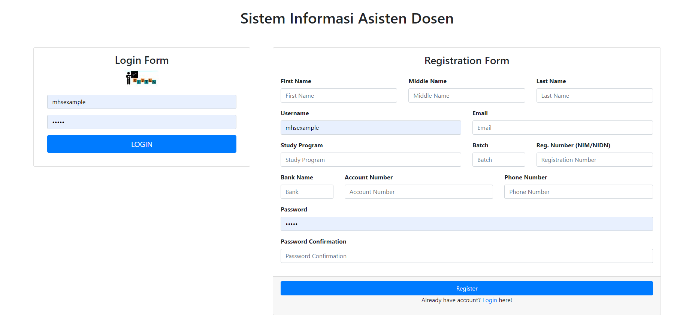
Register And Login View

Slide 9
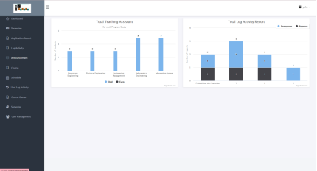
Dashboard view

Slide 10
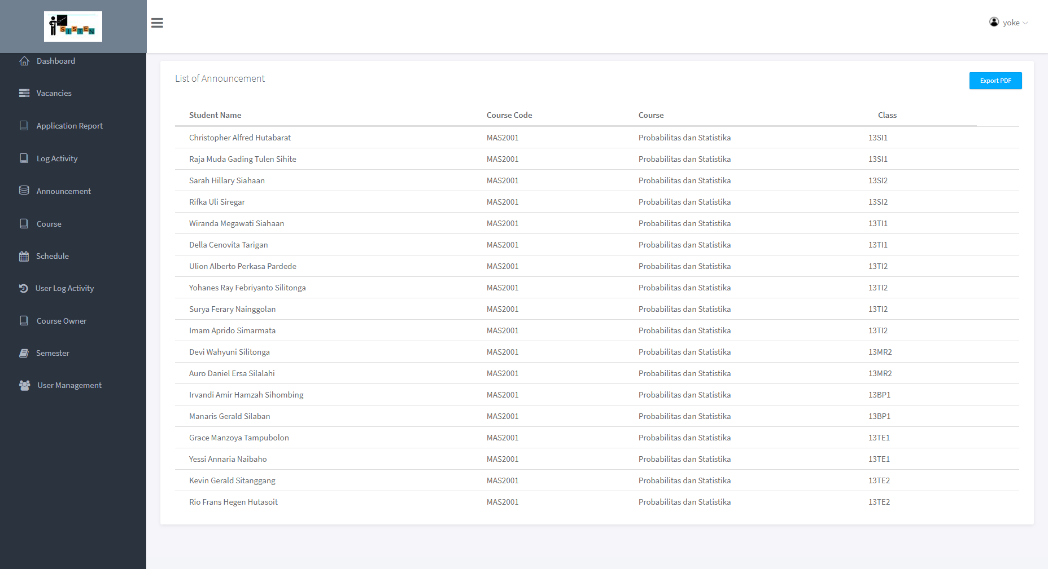
Announcement view

Slide 11
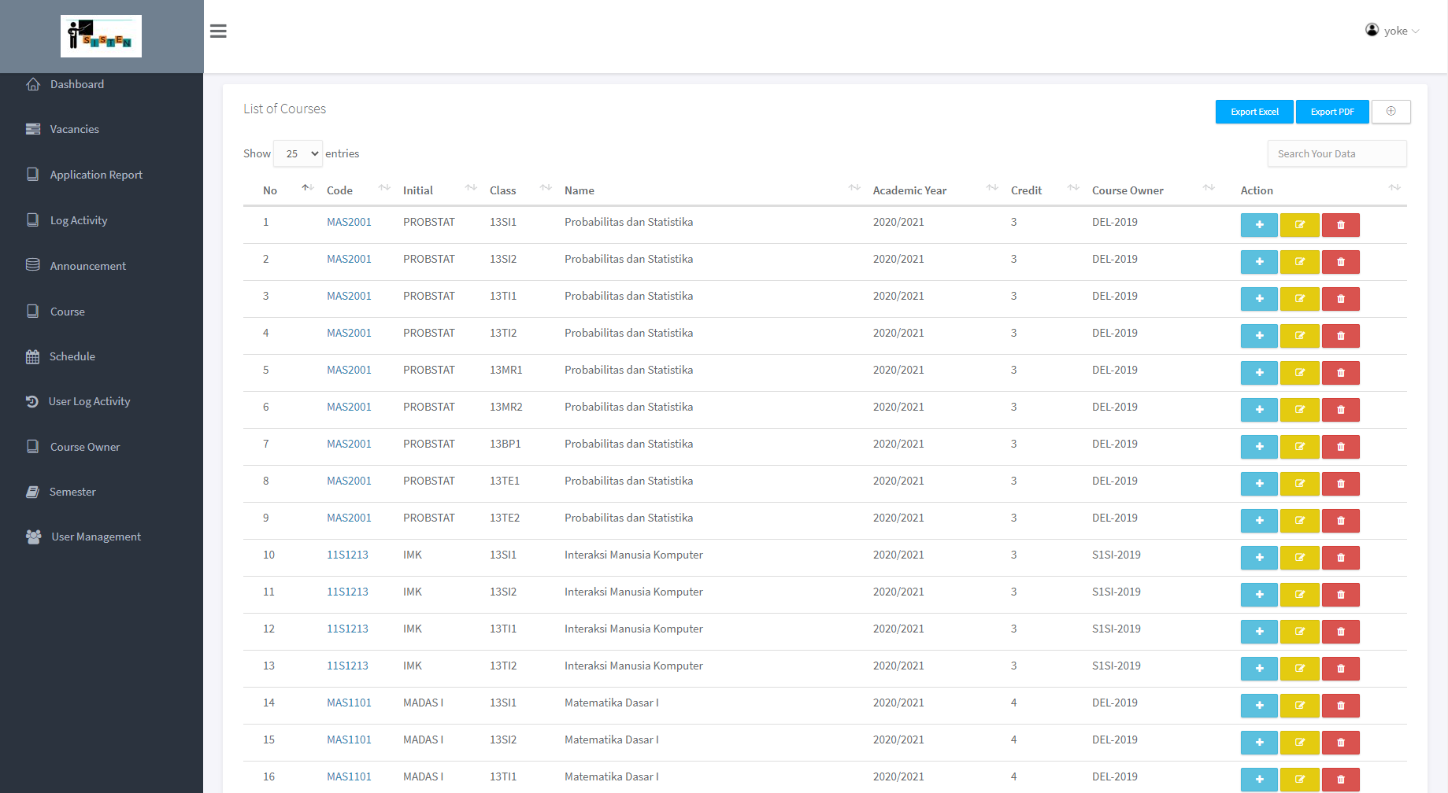
Courses view

Slide 12
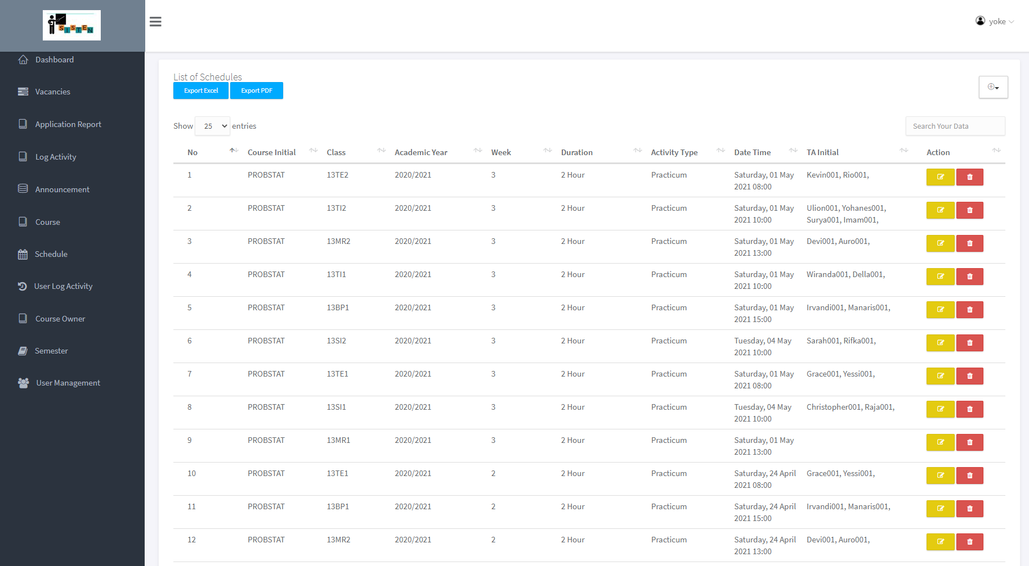
Schedule view

Slide 13
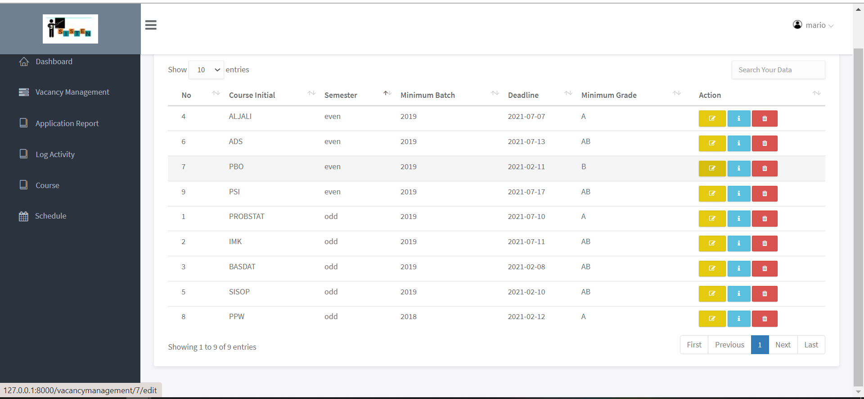
Vacancy Management View

Slide 14
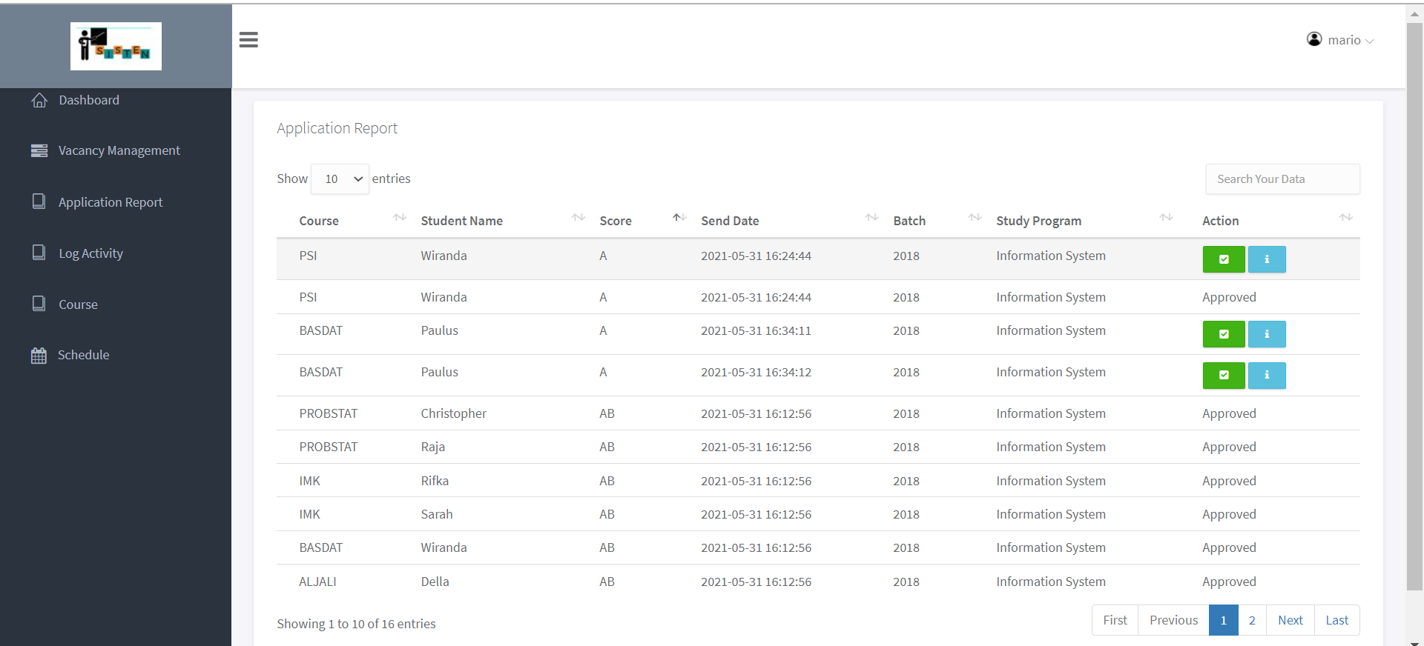
Application Report View

Slide 15
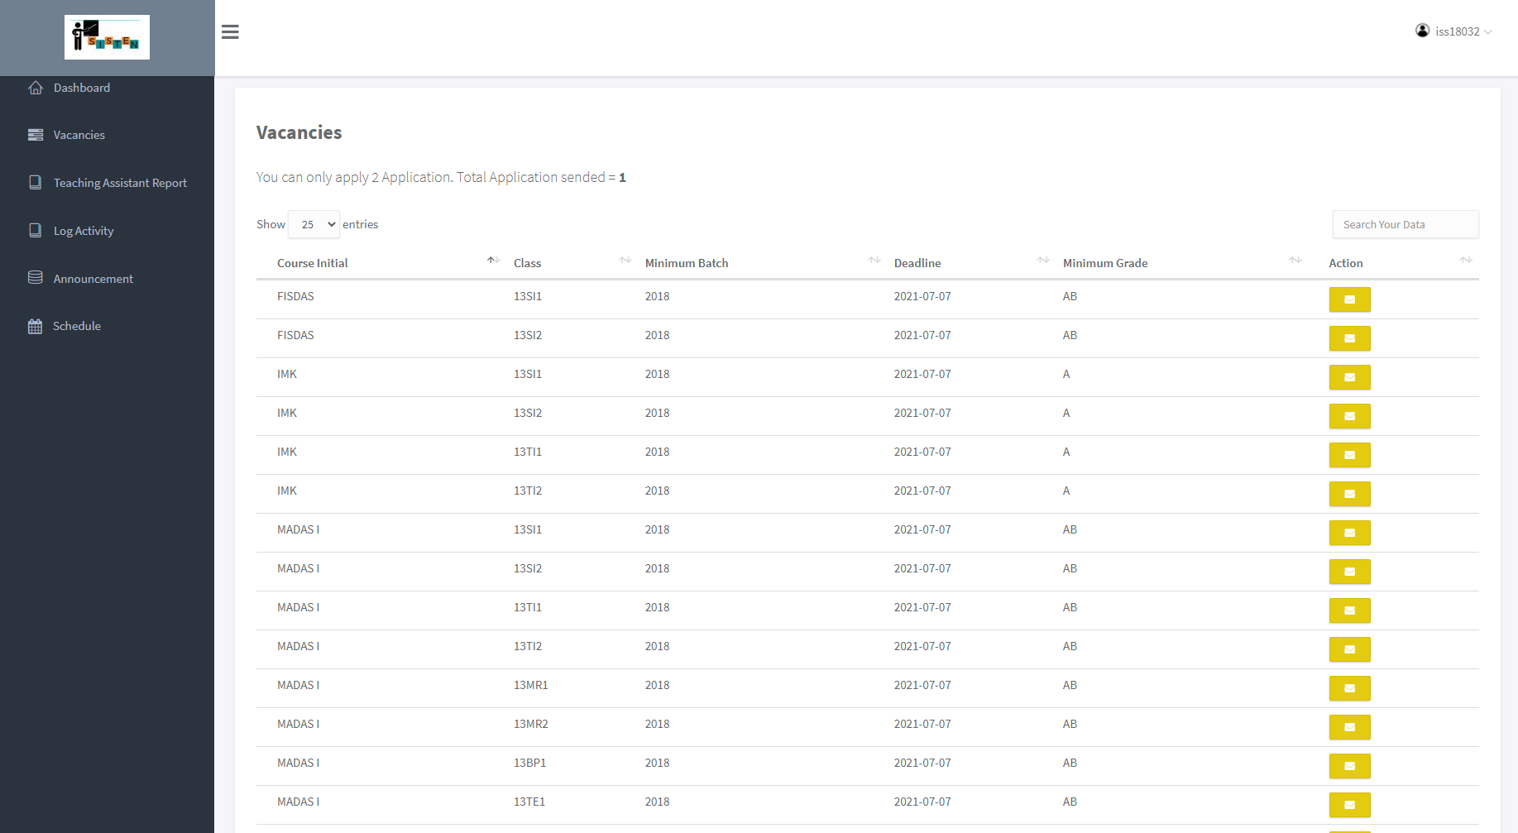
Vacancies View

Slide 16
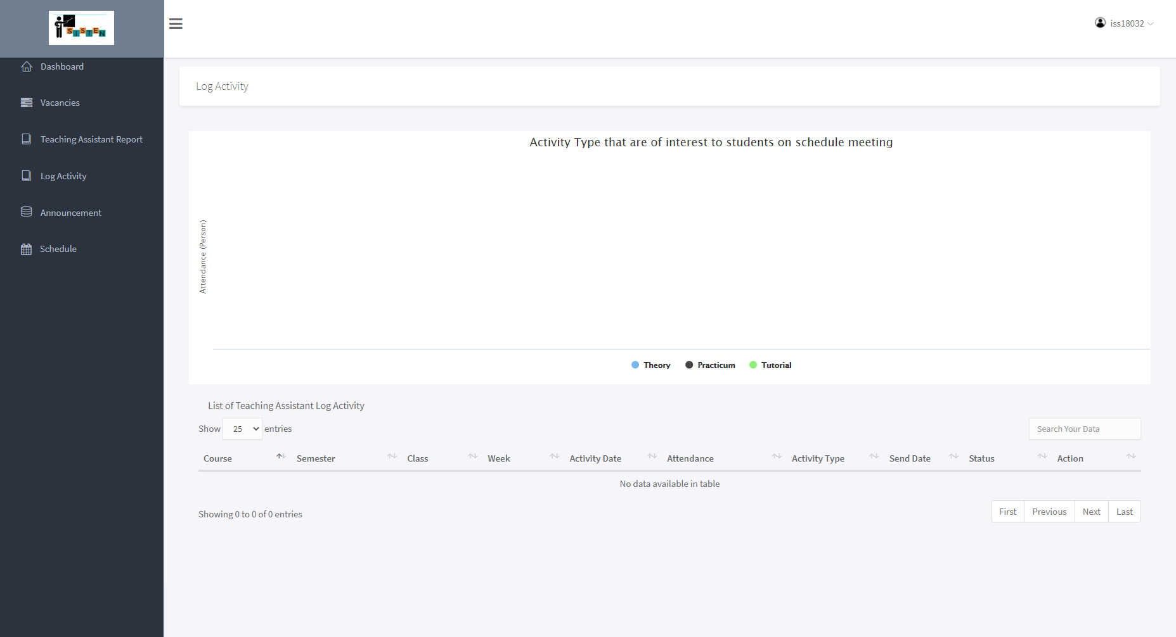
Log Activity view

Slide 17
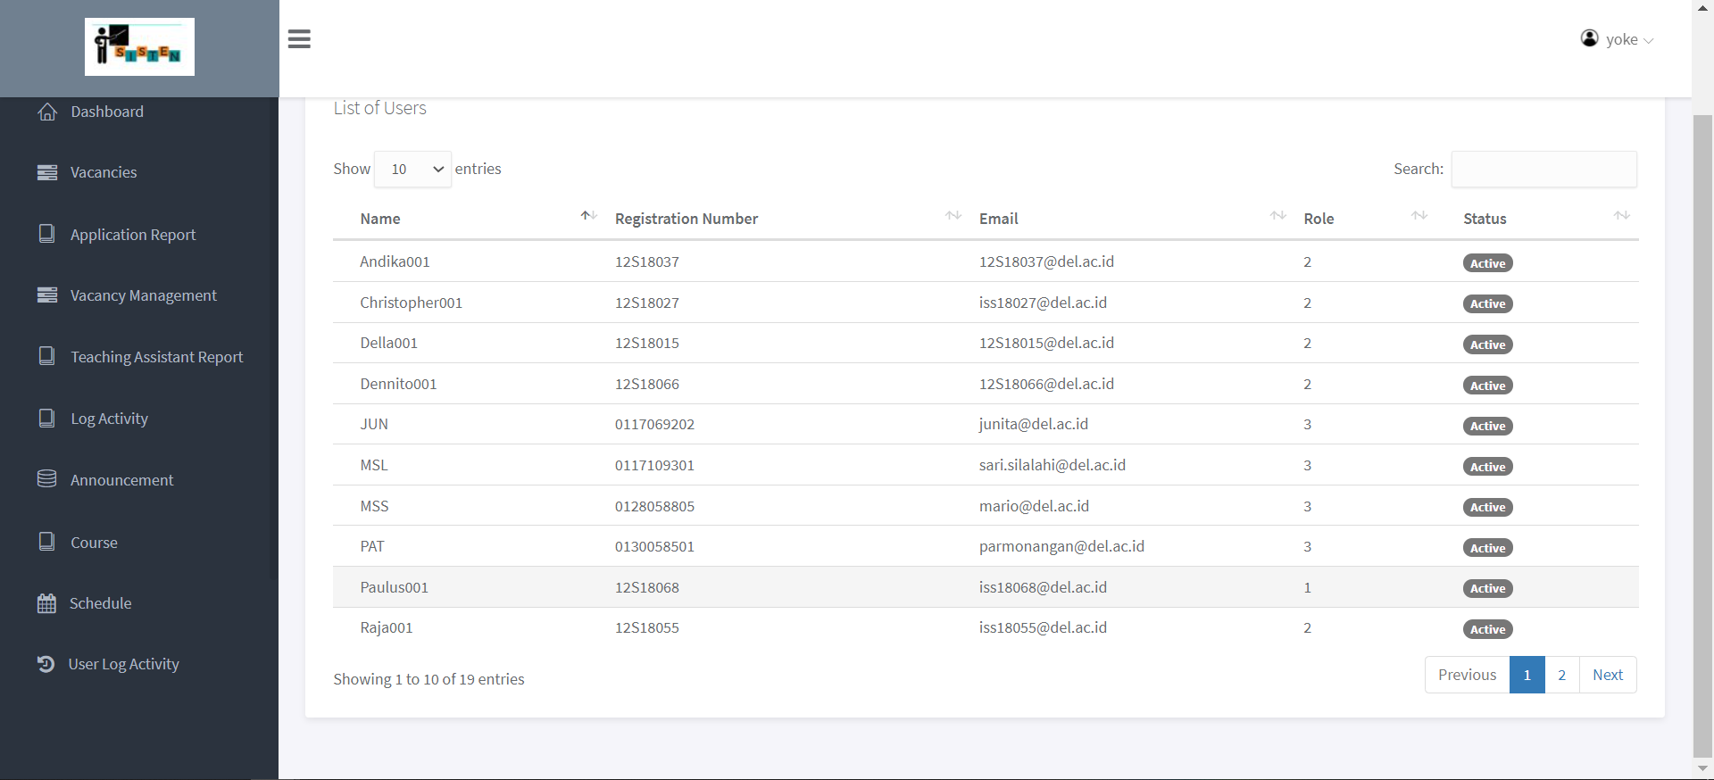
User Management view

Slide 18
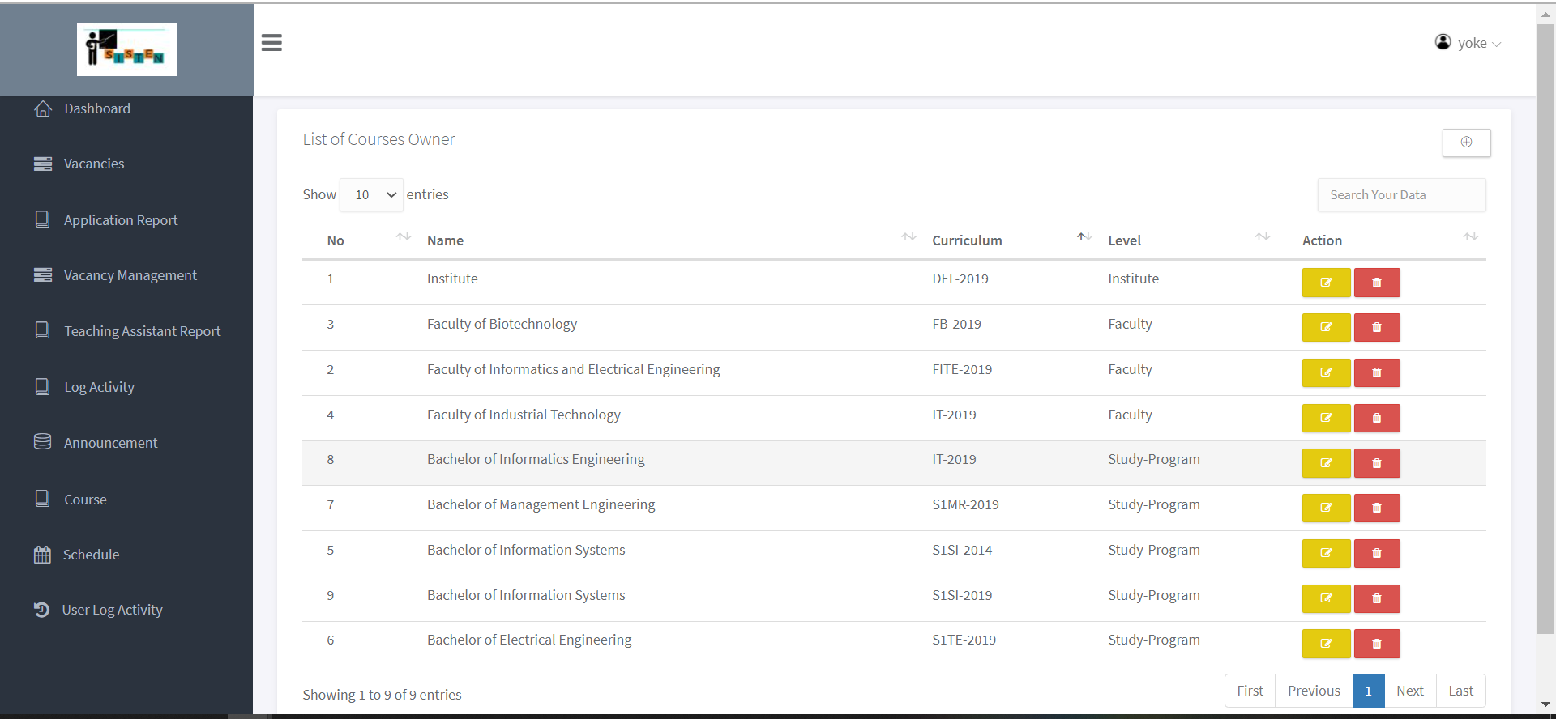
Course Owner view

Slide 19
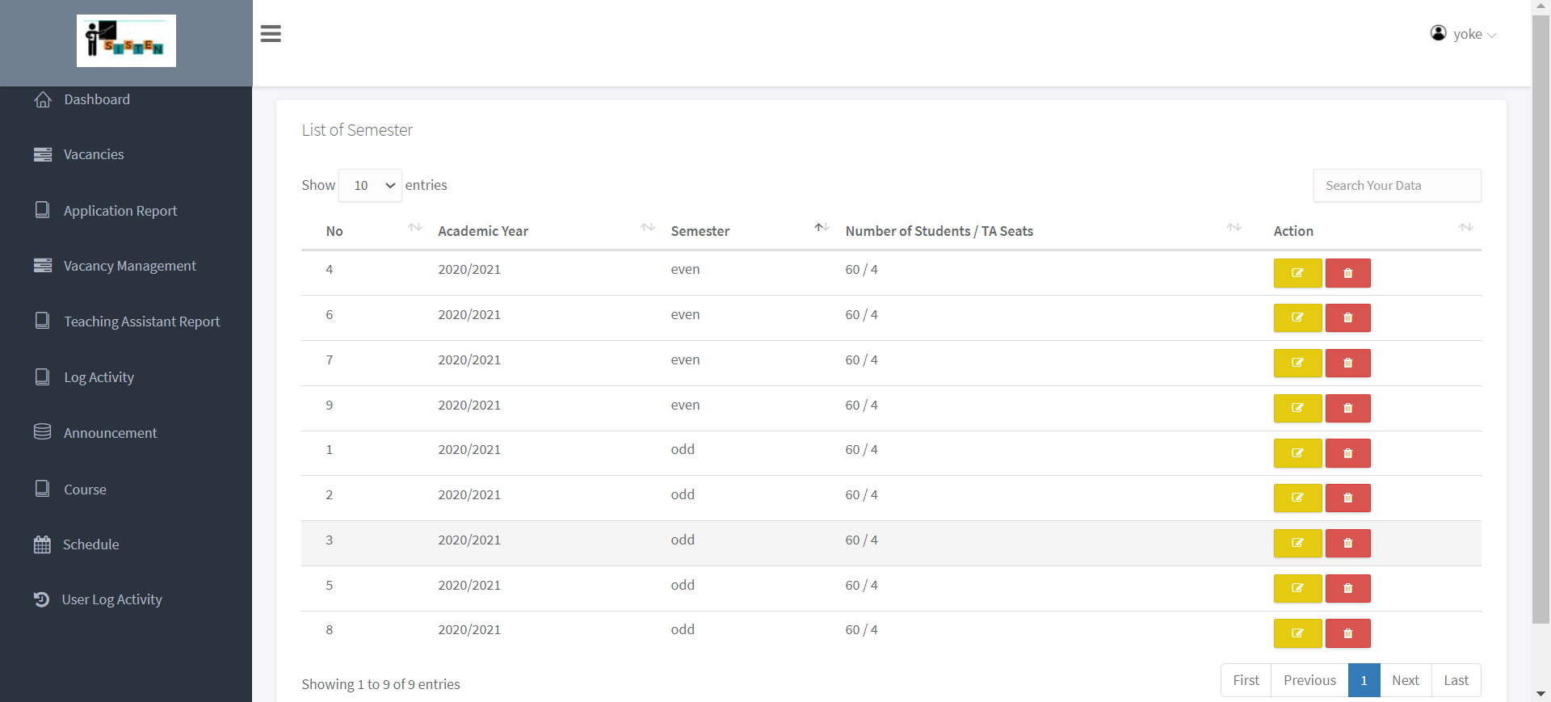
Semester view

Slide 20
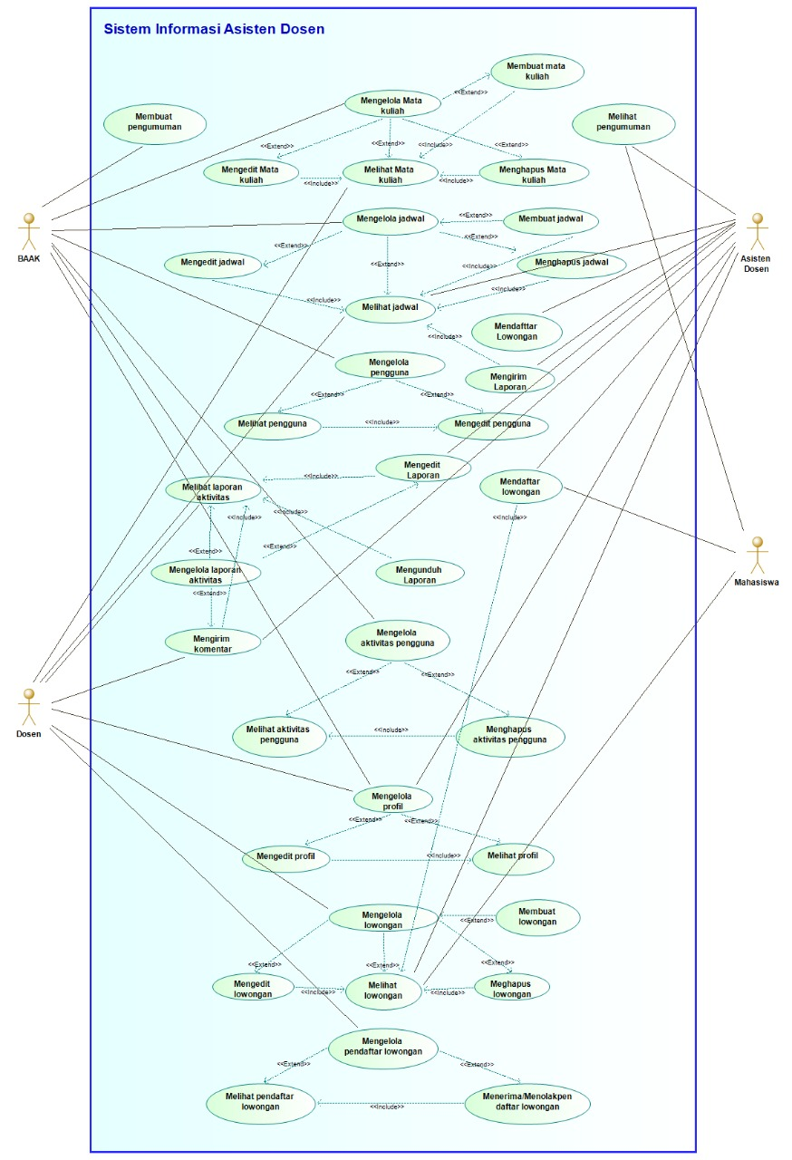
Use Case Diagram

Slide 21
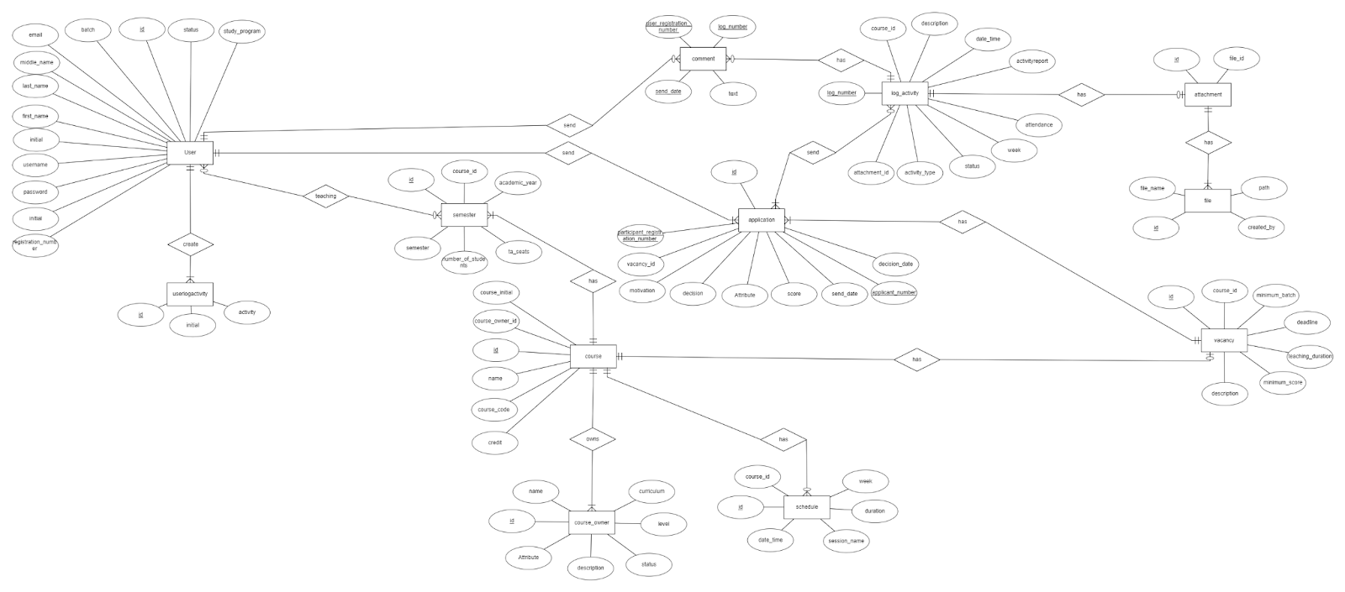
Entity Relationship Diagram

Slide 22
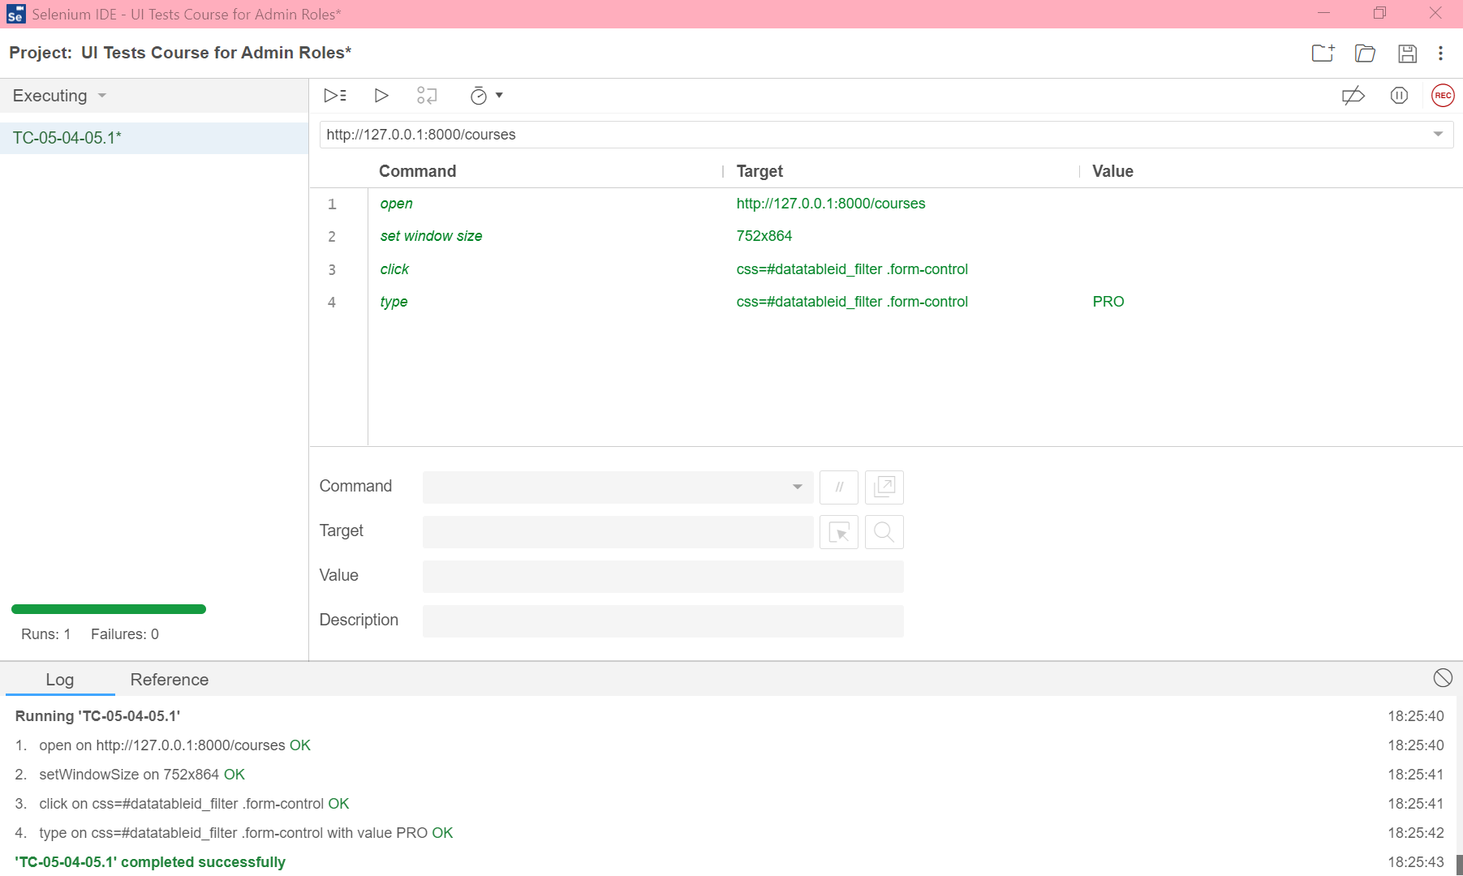

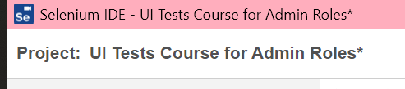
SISTEN Testing Mechanism Using Selenium IDE
Selenium IDE is designed to record user interactions with websites to help user generate and maintain site automation, test, and eliminate the need to manually step through repeated fetches. The following is the mechanism for testing:
Create a name for the testing project

Slide 23
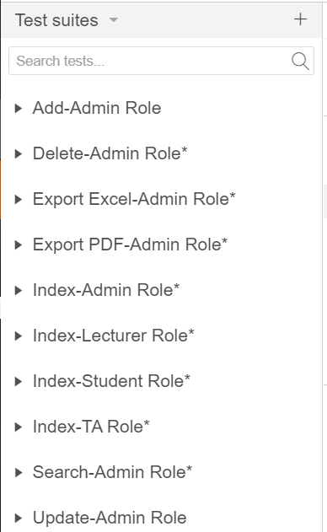
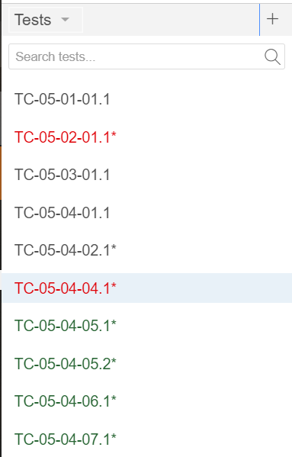
SISTEN Testing Mechanism Using Selenium IDE (Cont.)
2. Create a name for the test suites 3. Create a name for the test (unit)

Slide 24
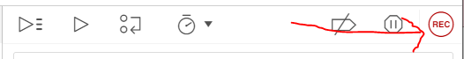
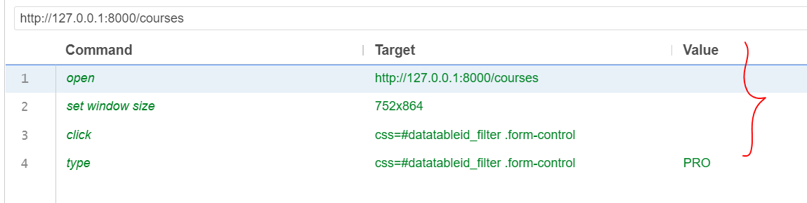
SISTEN Testing Mechanism Using Selenium IDE (Cont.)
4. Enter the URI of project inside the Base URL textbox
5. Click REC and take a step by step action from the project testing process.
Selenium IDE will record the script of every action taken and display it in the test script editor box.
Test script box can be edited according to the needs of the tester.

Slide 25

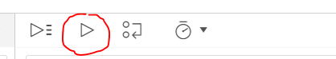
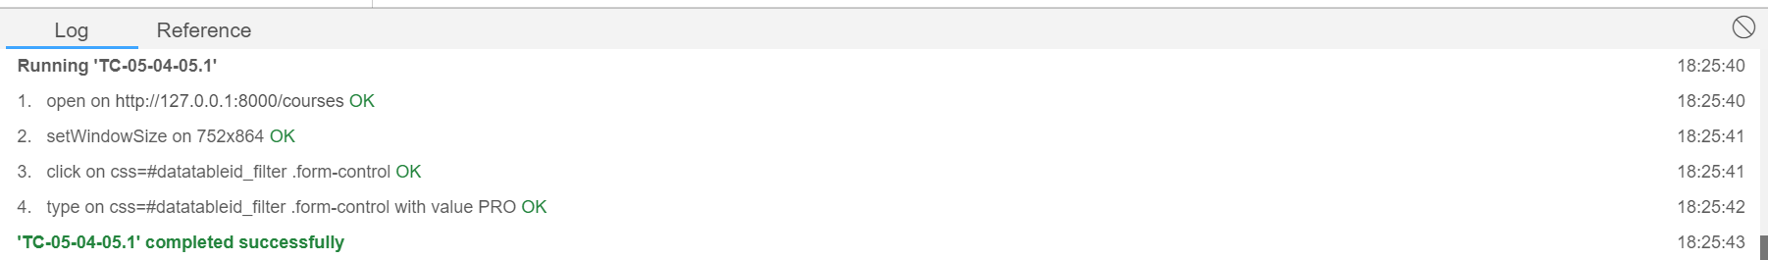
SISTEN Testing Mechanism Using Selenium IDE (Cont.)
6. Click stop recording button
7. Click Run Current Test button to start testing
8. Selenium IDE will automatically test according to the previously recorded script. The test results will be displayed in the Log section.

Slide 26
THANKS!

